Slide 1

Department of Computer Science Engineering
Title : pH and Turbidity: Multi-Parameter Water Quality Monitoring Using Edge-Integrated Sensing Platforms
PRESENTED BY
Alajangi Keerthisree (22471A05E3)
Katari Thanmai (22471A05G1)
Sonti Vineela (22471A05J6)
Under the Guidance of,
M.Suneetha,B.Tech.,M.Tech
Assistant Professor,
Department of Computer Science and Engineering,
Narasaraopeta Engineering College (Autonomous),
Narasaraopet- 522 601.

Slide 2
OUTLINE
Abstract
Introduction
Literature Survey
Research Gaps
Problem Statement
Objectives
Flow Chart
Methodology
Implementation
Results & Analysis
Comparative Analysis
Conclusion & Future Scope
References
Question and Answers

Slide 3
Abstract
Water pollution has become one of the most critical global issues affecting both the environment and human health. Traditional water quality monitoring systems depend on costly IoT-based sensors, which are difficult to maintain and unsuitable for rural areas. To overcome these challenges, this project proposes a software-based water quality monitoring framework that works without physical sensors. It uses publicly available datasets containing physicochemical parameters such as pH, turbidity, solids, chloramines, and organic carbon. A Pollution Severity Index (PSI) is developed to classify water quality into different levels. Various machine learning and deep learning models — Random Forest, FNN, LSTM, and GRU — were trained and compared. Among them, the GRU model achieved the highest accuracy of 92%, showing excellent reliability and generalization. This system provides a low-cost, scalable, and sustainable solution for monitoring water quality, supporting the goal of Clean Water and Sanitation (SDG-6).

Slide 4
Introduction
Background:
Water is essential for life, yet pollution caused by industrialization, urbanization, and climate change has made clean water access a global challenge.
Motivation:
Traditional water monitoring systems use IoT-based physical sensors that are expensive, difficult to maintain, and not suitable for rural or low-resource areas.
Problem with Existing Systems:
Most existing systems measure only a few parameters like pH and turbidity and require constant hardware maintenance and internet connectivity.
Proposed Solution:
This project introduces a sensor-free, software-based water quality monitoring framework using machine learning techniques and publicly available datasets.
Importance:
The system provides an affordable, scalable, and reliable solution for predicting water quality, supporting the United Nations Sustainable Development Goal 6 (Clean Water and Sanitation).

Slide 5
Literature Survey
No | Title | Author | Journal Name & Year | Methodology Adopted | Key Findings | Gaps
1 | Machine Learning-Based Water Quality Classification Assessment | Chen et al. | Water Journal,2024 | Used Random Forest, SVM, and XGBoost for classification | Achieved 88% accuracy in surface water analysis | Focused on single parameter, lacks scalability
2 | Hybrid Deep Learning Models for Seasonal Water Quality Prediction | Paneru et al. | arXiv preprint, 2024 | Combined CNN–RNN with LIME for interpretability | Improved regression accuracy and interpretability | Poor cross-regional generalization
3 | Machine Learning Framework for Predicting Water Quality Classification | Sangwan & Bhardwaj | Water Practice & Technology, 2024 | Used RF, SVM, and XGBoost for WQI classification | Achieved 89% accuracy on multisource data | High computational cost, not suited for low-resource areas

Slide 6
Literature Survey
No | Title | Author | Journal Name & Year | Methodology Adopted | Key Findings | Gaps
4 | Interpretable ML-Based Quantification of Water Pollution Impact | Zhang et al. | Water Journal, 2025 | Applied XGBoost with SHAP for feature importance | Applied XGBoost with SHAP for feature importance | Limited to groundwater datasets
5 | Open Sensing System for Low-Cost Water Quality Monitoring | Quevy et al. | IEEE Open Journal of the Industrial Electronics Society, 2023 | Developed an open-source IoT buoy for real-time monitoring | Enabled affordable, energy-efficient data collection | Still depends on physical sensors

Slide 7
Research Gaps
Research Gaps Identified
Most existing water quality monitoring systems depend heavily on physical IoT sensors, making them costly and difficult to maintain.
Many studies consider only one or two parameters (like pH or temperature) instead of analyzing multiple physicochemical parameters together.
Machine learning models used in previous research often show poor generalization when applied to new or unseen datasets.
Traditional methods lack a unified index to combine multiple parameters into a single pollution score.
Existing approaches are not suitable for rural or low-resource areas due to their high setup cost and maintenance requirements.
Limited research is available on a sensor-free, fully data-driven water quality prediction system.

Slide 8

Research Gaps
How Our Project Addresses These Gaps
Introduces a sensor-free water quality monitoring system based entirely on machine learning and publicly available datasets.
Considers multiple key parameters (pH, turbidity, solids, chloramines, organic carbon) for accurate multi-parameter analysis.
Uses advanced deep learning models like GRU, which provide 92% accuracy and strong generalization across different datasets.
Develops a Pollution Severity Index (PSI) to combine all parameters into one meaningful pollution score.
Offers a low-cost, scalable, and maintenance-free solution suitable for rural and low-resource regions.
Ensures a sustainable and data-driven approach aligned with SDG-6 (Clean Water and Sanitation).

Slide 9
Problem Statements
Need for Affordable Monitoring:
Existing water quality monitoring systems rely on costly IoT sensors and hardware components, making them unaffordable for rural and low-income regions.
Maintenance Challenges:
Sensor-based systems require regular calibration, maintenance, and connectivity, which limits their large-scale deployment.
Limited Data Coverage:
Most existing models analyze only a few parameters, such as pH or turbidity, instead of considering multiple influencing factors.
Lack of Scalability:
Traditional methods are not easily adaptable for real-time, large-scale water quality prediction across different environments.
Accuracy and Reliability Issues:
Existing models often suffer from overfitting and lack reliability when predicting unseen water data.
Research Gap Addressed:
This project aims to develop a sensor-free, machine learning-based system that predicts water quality using publicly available datasets, achieving high accuracy and low cost through the GRU model.

Slide 10
Objectives
Main Objective:
To develop a sensor-free, machine learning-based water quality monitoring system that predicts pollution levels using publicly available datasets.
Specific Objectives:
1. Data Collection & Preprocessing:
To collect and preprocess water quality datasets containing key parameters such as pH, turbidity, chloramines, solids, and organic carbon.
2. Pollution Severity Index (PSI):
To design a Pollution Severity Index that combines multiple water parameters to classify water quality into different levels (Low, Moderate, Severe, Critical).
3. Model Development & Comparison:
To train and compare different machine learning and deep learning algorithms such as Random Forest, FNN, LSTM, and GRU for accuracy and reliability.
4. Real-Time Applicability:
To build a low-cost, scalable, and sustainable system suitable for rural and resource-limited areas.

Slide 11
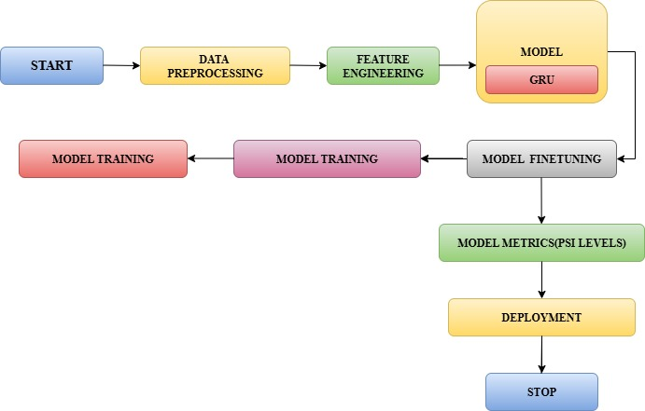
Flow Chart

Slide 12
Methodology
Data Collection & Preprocessing:
Collected publicly available water quality datasets and cleaned, normalized them for model training.
Feature Engineering:
Selected key parameters like pH, turbidity, solids, and chloramines to develop a Pollution Severity Index (PSI).
Model Training & Evaluation:
Trained multiple models — Random Forest, FNN, LSTM, and GRU — and evaluated their performance using accuracy and F1-score.
Final Model Selection:
The GRU model achieved the best results with 92% accuracy, making it the final model for water quality prediction.

Slide 13
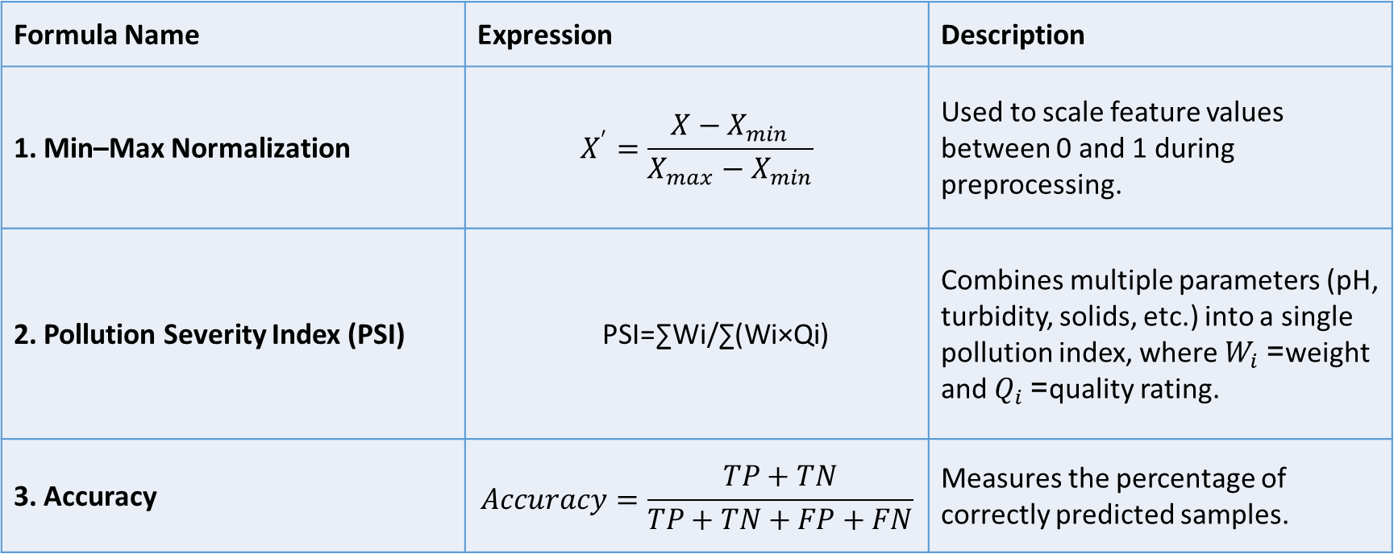
Methodology
Formula Name | Expression | Description
1. Min–Max Normalization | $$X^{′}=\frac{X−X_{min}}{X_{max}−X_{min}}$$ | Used to scale feature values between 0 and 1 during preprocessing.
2. Pollution Severity Index (PSI) | PSI=∑Wi​/∑(Wi​×Qi​)​ | Combines multiple parameters (pH, turbidity, solids, etc.) into a single pollution index, where $W_{i}$= weight and $Q_{i}$= quality rating.
3. Accuracy | $$Accuracy=\frac{TP+TN}{TP+TN+FP+FN}$$ | Measures the percentage of correctly predicted samples.

Slide 14
Methodology
Category | Tool / Library Used | Functionality
Programming Language | Python | Main language used for data processing, model training, and evaluation.
Development Environment | Google Colab / Jupyter Notebook | Used for coding, executing, and visualizing results.
Libraries for Data Handling | Pandas, NumPy | Used for data cleaning, preprocessing, and manipulation.
Machine Learning Libraries | Scikit-learn, TensorFlow, Keras | For model building, training, and performance evaluation.
Visualization Tools | Matplotlib, Seaborn | Used to visualize correlations, graphs, and model accuracy.
Dataset Source | Kaggle / Public Water Quality Dataset | Provides physicochemical data like pH, turbidity, and solids.
Algorithm Used | GRU (Gated Recurrent Unit) | Final model used for accurate and reliable water quality prediction.

Slide 15

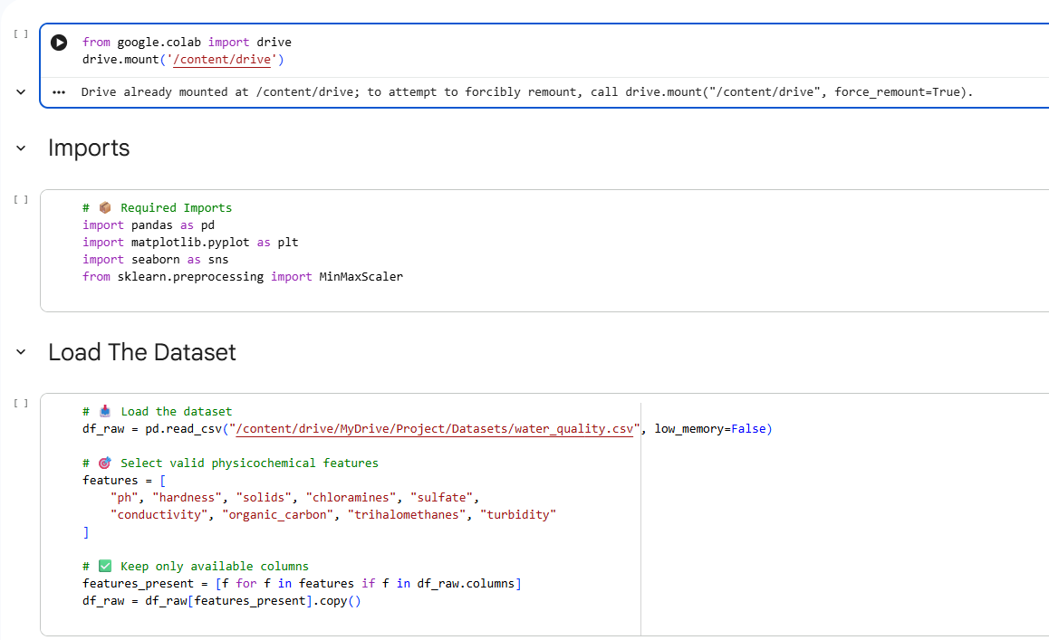

Slide 16
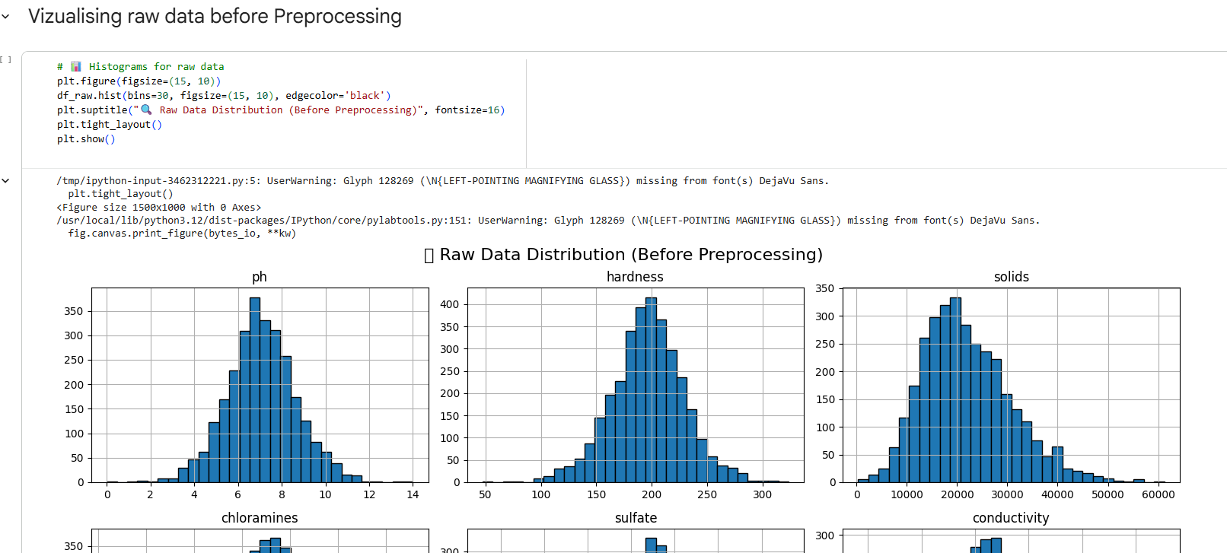

Slide 17

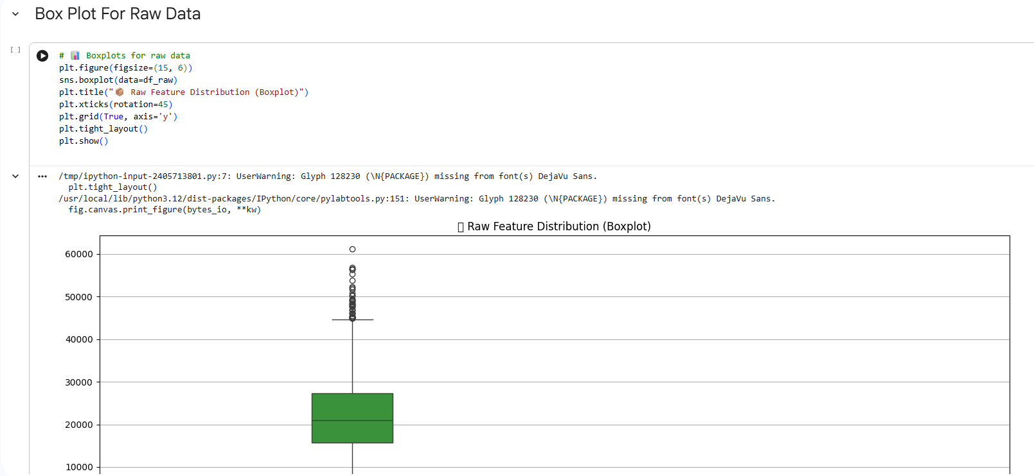

Slide 18
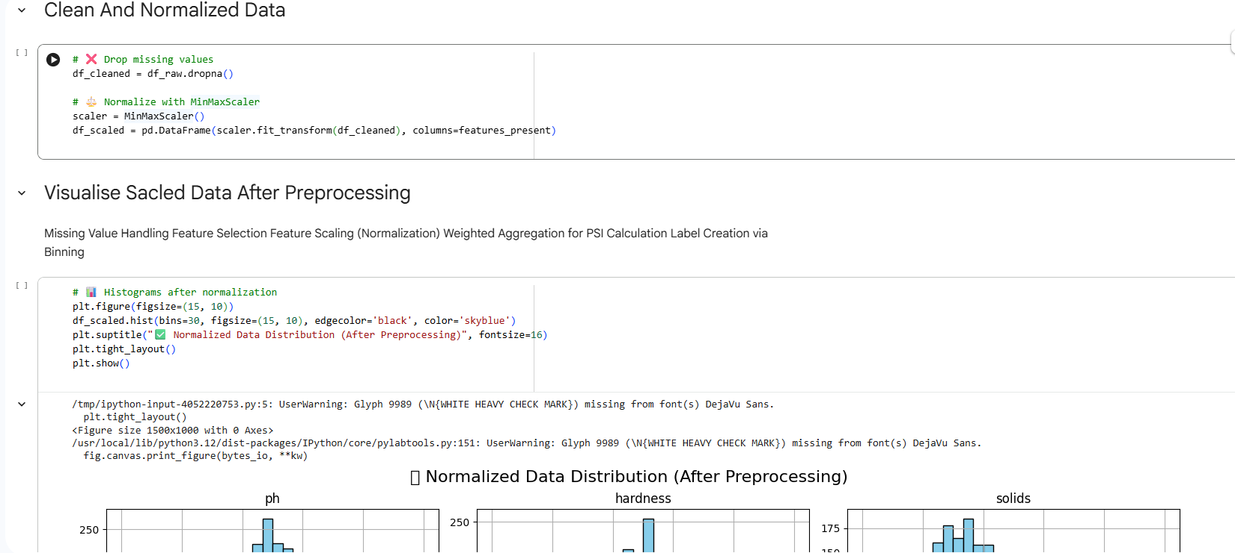

Slide 19
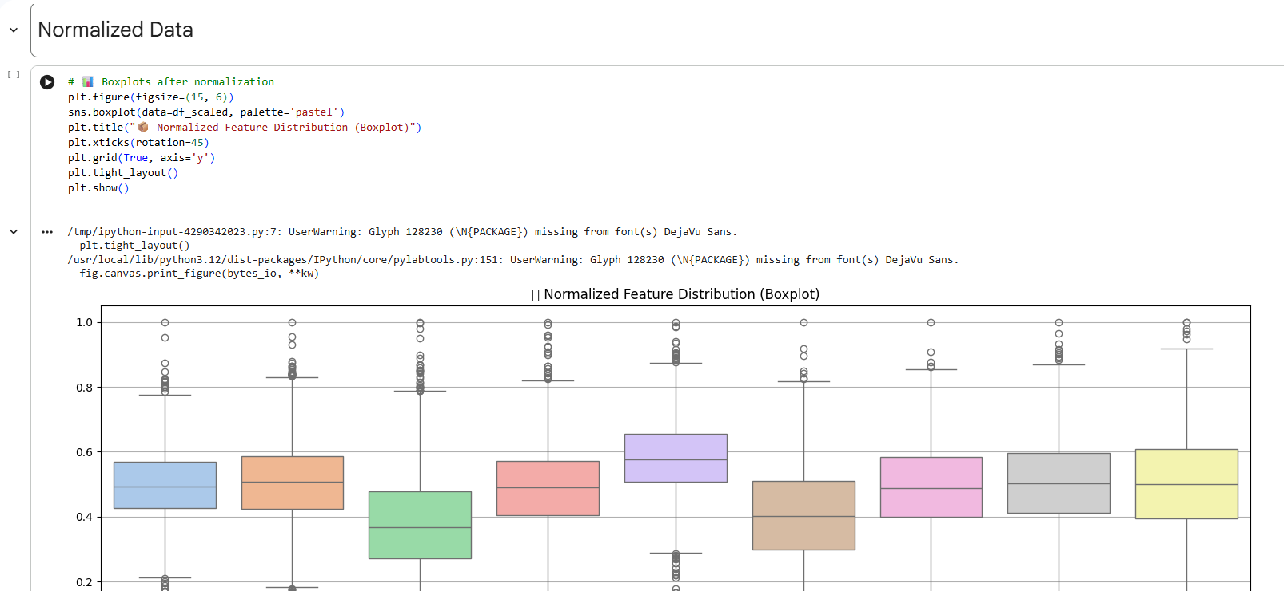

Slide 20
Implementation
Software Implementation | Hardware Implementation
Python used for model development and data processing. | Intel i5/i7 processor for efficient computation.
Google Colab used as the development and testing platform. | 8 GB RAM for smooth execution and model training.
TensorFlow and Keras used for building and training the GRU model. | 500 GB HDD/SSD storage for datasets and results.
Matplotlib and Pandas used for visualization and data handling. | GPU (optional) used to speed up deep learning model training.

Slide 21
Implmentation
Challenges | Solutions Applied
High cost and maintenance of physical IoT sensors. | Developed a sensor-free, software-based system using machine learning and open datasets.
Inconsistent and noisy water quality data. | Applied data preprocessing and normalization techniques to improve accuracy.
Limited prediction accuracy in traditional models. | Implemented and optimized GRU model, achieving 92% accuracy.
Difficulty in combining multiple water parameters. | Designed a Pollution Severity Index (PSI) to integrate all parameters into a single score.

Slide 22
Results & Analysis
Model Used | Accuracy (%) | Precision (%) | Recall (%)
Random Forest (RF) | 84% | 82% | 80%
Feedforward Neural Network (FNN) | 87% | 85% | 84%
Long Short-Term Memory (LSTM) | 90% | 89% | 88%
Gated Recurrent Unit (GRU) | 92% | 91% | 90%

Slide 23
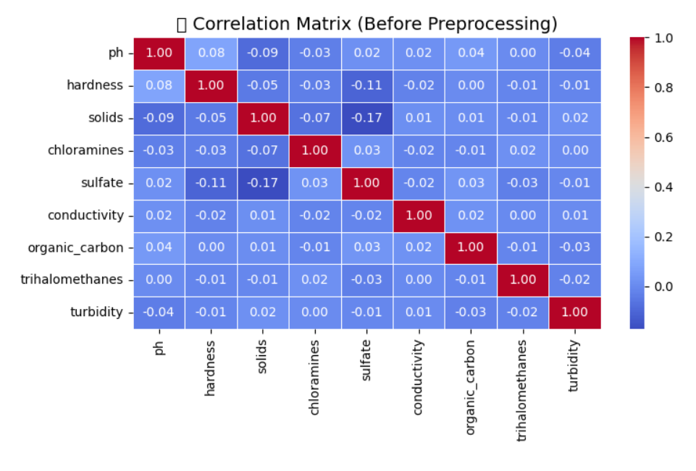
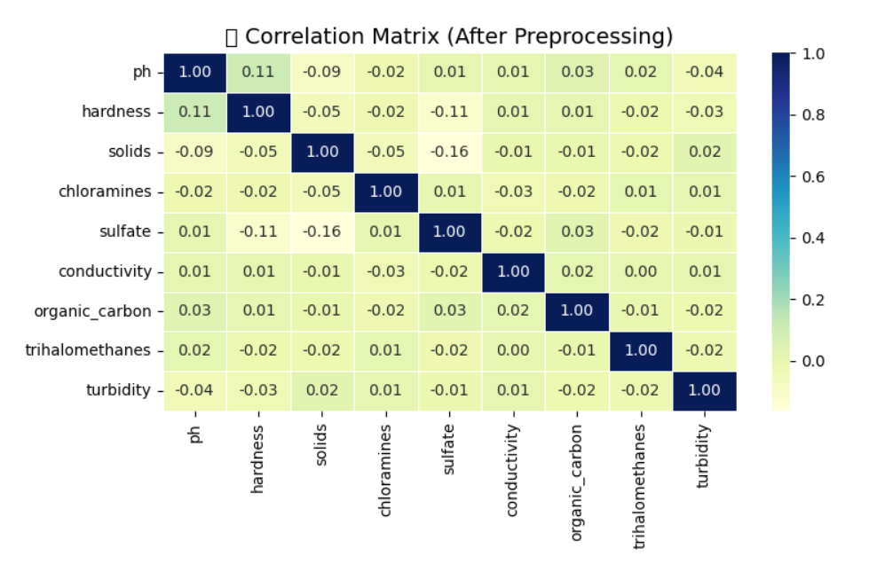
Results & Analysis

Slide 24
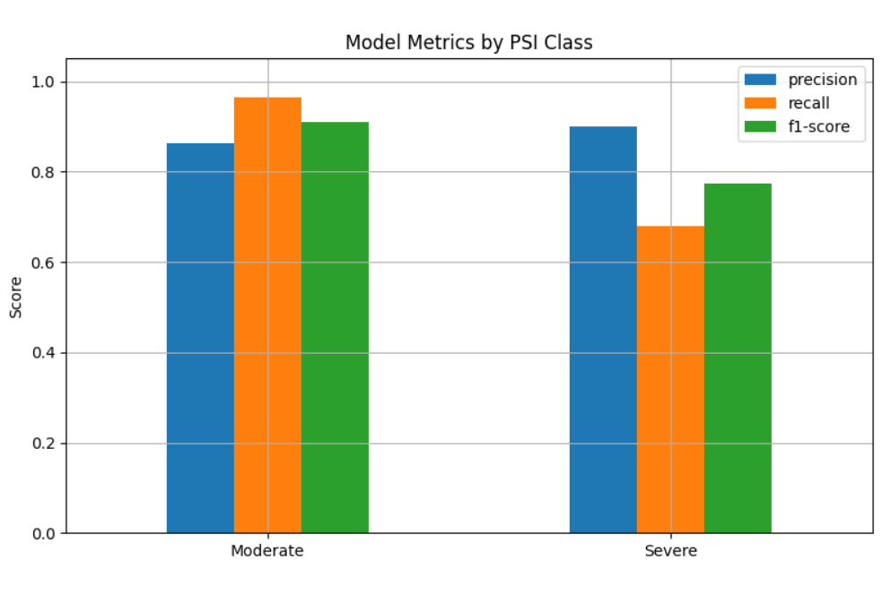
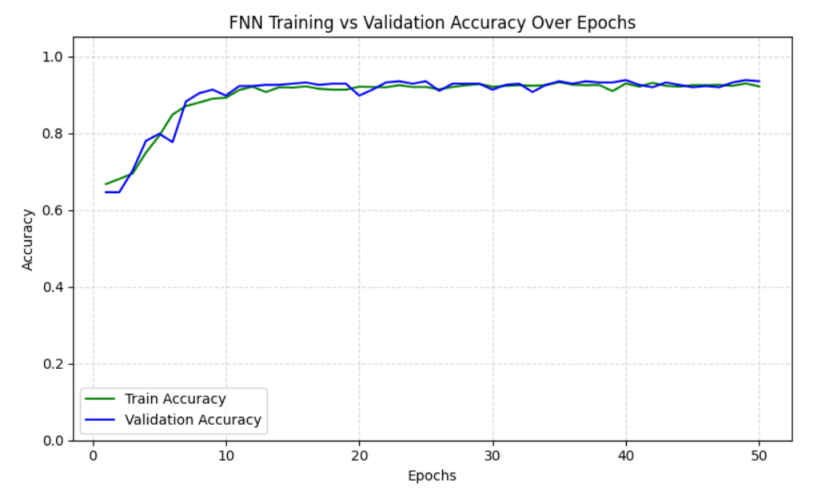
Results & Analysis

Slide 25
Conclusion & Future Scope
A sensor-free, machine learning-based system for water quality monitoring was successfully developed.
The system uses publicly available datasets containing key parameters like pH, turbidity, solids, and chloramines.
Multiple models were tested — Random Forest, FNN, LSTM, and GRU — to identify the most accurate one.
The GRU model achieved the highest accuracy of 92%, proving to be reliable and efficient for water quality prediction.
This approach offers a low-cost, scalable, and sustainable solution for monitoring water quality in rural and resource-limited areas.
The project supports Sustainable Development Goal 6 (Clean Water and Sanitation) by promoting affordable water monitoring methods.

Slide 26
References
Chen, Y., et al., “Machine Learning-Based Water Quality Classification Assessment,” Water Journal, vol. 16, no. 5, pp. 1224–1235, 2024.
Paneru, A., et al., “Hybrid Deep Learning Models for Seasonal Water Quality Prediction,” arXiv preprint arXiv:2405.13456, 2024.
Sangwan, A., and Bhardwaj, A., “Machine Learning Framework for Predicting Water Quality Classification,”
Water Practice & Technology, vol. 19, no. 3, pp. 945–954, 2024.
Zhang, H., et al., “Interpretable ML-Based Quantification of Water Pollution Impact,” Water Journal, vol. 17, no. 2, pp. 567–579, 2025.
Quevy, E., et al., “Open Sensing System for Low-Cost Water Quality Monitoring,” IEEE Open Journal of the Industrial Electronics Society, vol. 4, pp. 210–220, 2023.
Li, J., et al., “Deep Learning Approaches for Predicting Surface Water Quality Parameters,” Environmental Modelling & Software, vol. 170, pp. 105457, 2023.
Kaur, R., et al., “IoT-Based Smart Water Quality Monitoring System Using Machine Learning,” IEEE Access, vol. 12, pp. 13245–13255, 2024.
Alvarado, M., et al., “Water Quality Prediction Using Recurrent Neural Networks,” Environmental Science and Pollution Research, vol. 31, pp. 1230–1243, 2024.

Slide 27
References
Dutta, A., and Sharma, S., “Comparative Study of ML Algorithms for Water Quality Index Prediction,” Applied Water Science, vol. 14, no. 2, pp. 1–12, 2024.
Gupta, P., et al., “Real-Time Water Quality Analysis Using IoT and Cloud Computing,” International Journal of Advanced Computer Science and Applications, vol. 14, no. 4, pp. 42–48, 2023.
Rahman, M., et al., “Data-Driven Prediction of Water Quality Using Ensemble Learning,” Sustainability, vol. 15, no. 6, pp. 4542–4555, 2023.
Singh, N., and Kumar, R., “An Intelligent System for Water Quality Monitoring Using AI,” IEEE Transactions on Instrumentation and Measurement, vol. 73, pp. 1–9, 2024.
Patel, D., et al., “Implementation of GRU and LSTM for Water Quality Forecasting,” Computers and Electronics in Agriculture, vol. 213, pp. 108022, 2024.
Bhattacharya, T., et al., “Water Pollution Prediction Using Machine Learning and Statistical Models,” Scientific Reports, vol. 14, no. 7, pp. 1002–1012, 2025.
Ibrahim, H., et al., “IoT and Machine Learning Based Water Quality Monitoring System,” IEEE Sensors Journal, vol. 23, no. 9, pp. 11455–11463, 2023.
Roy, A., et al., “Hybrid CNN–GRU Model for River Water Quality Prediction,” Journal of Environmental Management, vol. 355, pp. 120212, 2024.

Slide 28

Questions and Answers
Thank you for your attention!
We’d now like to open the floor for any questions or feedback.

Slide 29

Acknowledgements

